Slide 1

GUIs in Python

Slide 2

Objectives
GUI
What is a GUI?
How does it relate to Python?

Slide 3
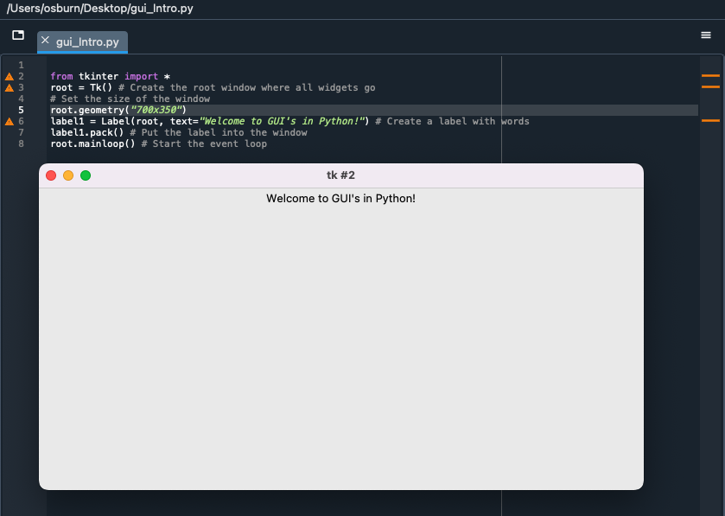
GUI
What is a GUI?
Graphical user interface.
Using Spyder.
Import tkinter.
Widget that allows you to create windows.
Text label.
Button.
Drop-down menu.
Scroll bar.
Etc.

Slide 4
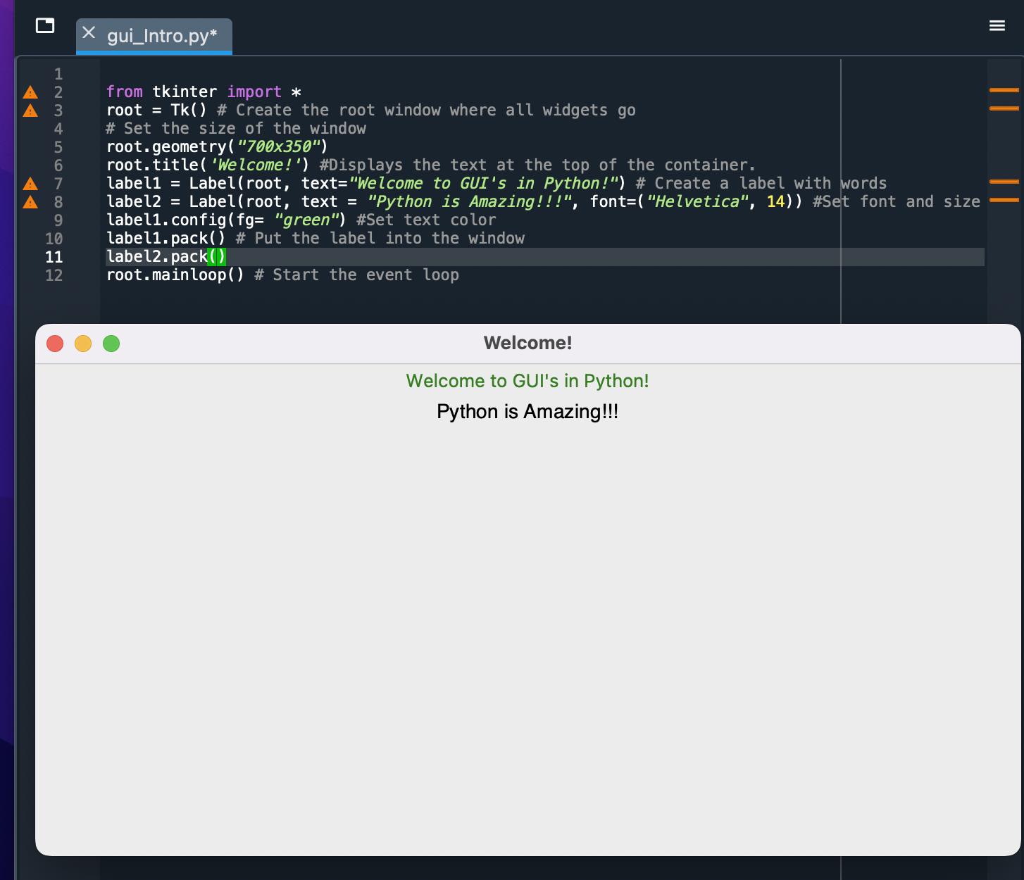
GUI
Labels
Font.
Name
Size
Color.

Slide 5
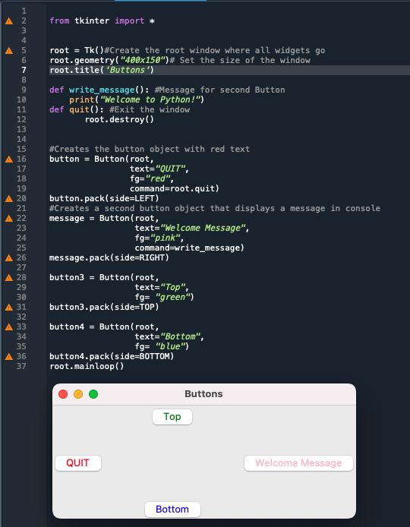
GUI
Buttons
Font.
Name, size.
Position.
Color.
Actions

Slide 6
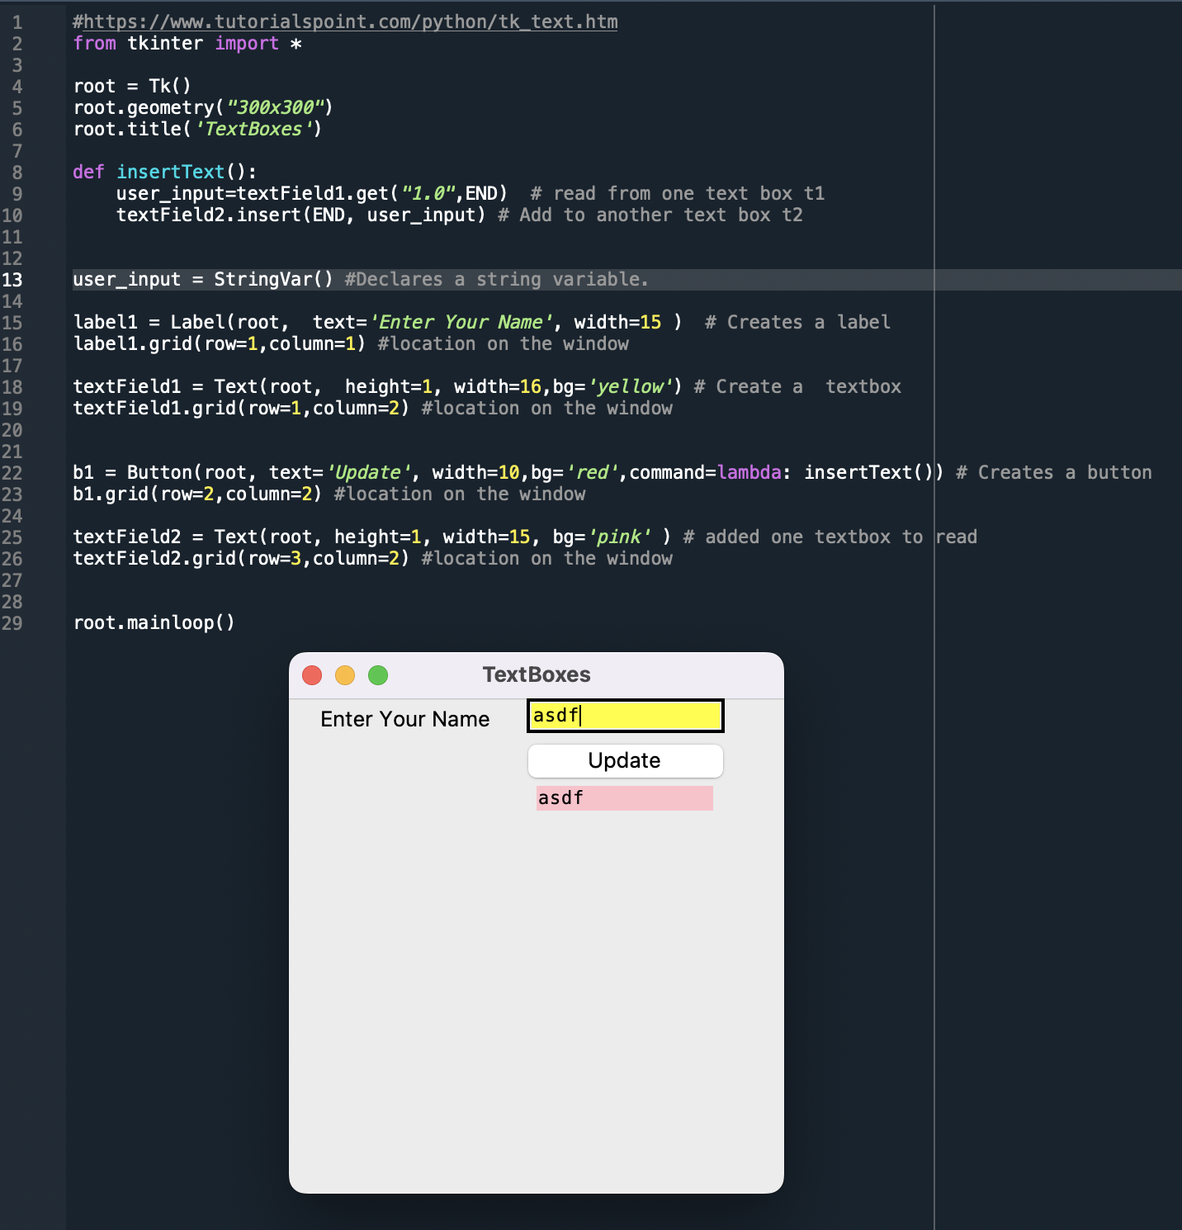
GUI
TextBox

Slide 7
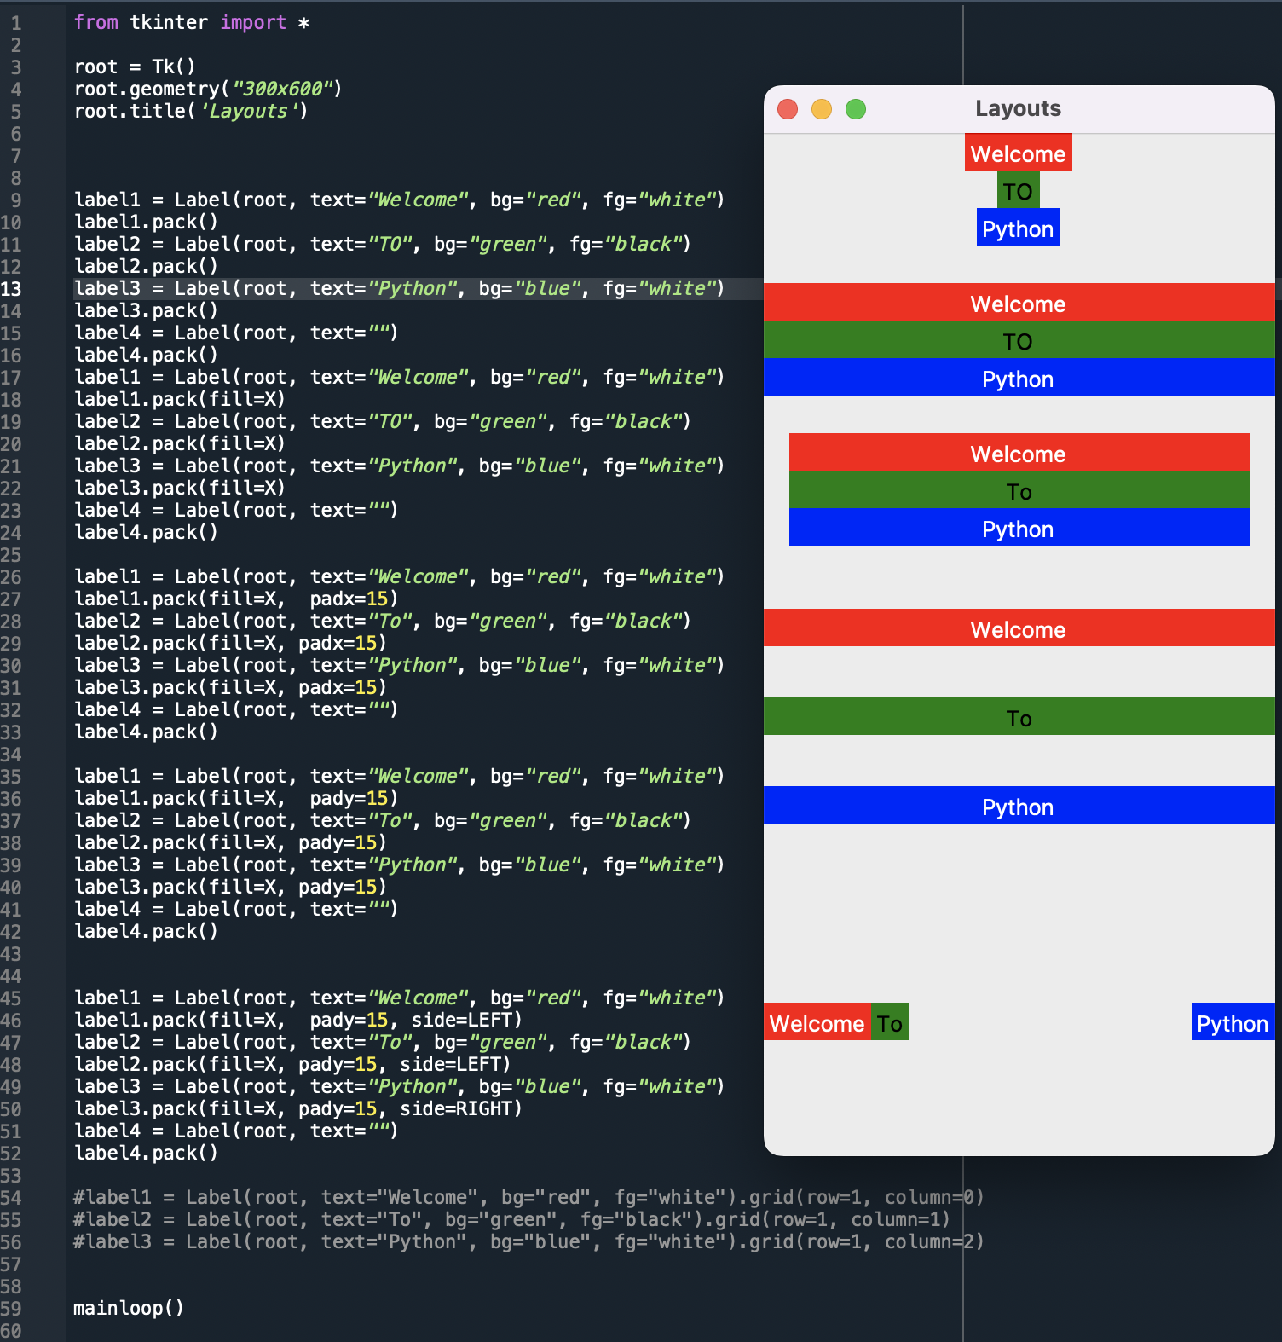
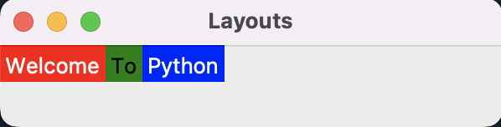
GUI
Layouts
Fill.
Padding.
padx = horizontally.
pady = vertically.
Side by side.
Grid.

Slide 8
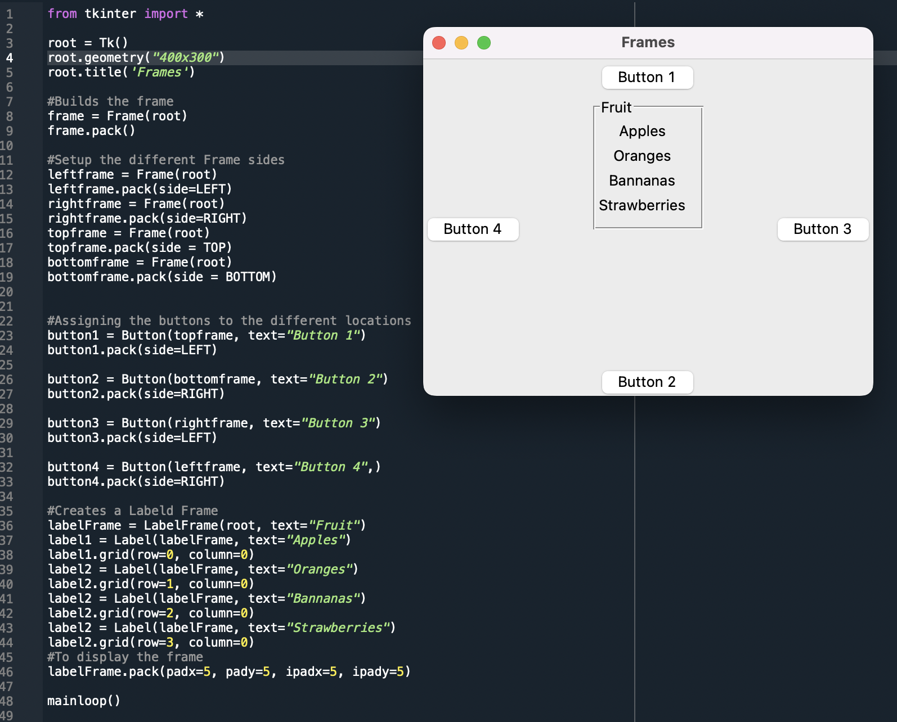
GUI
Frames
Locations.
Label frame.

Slide 9
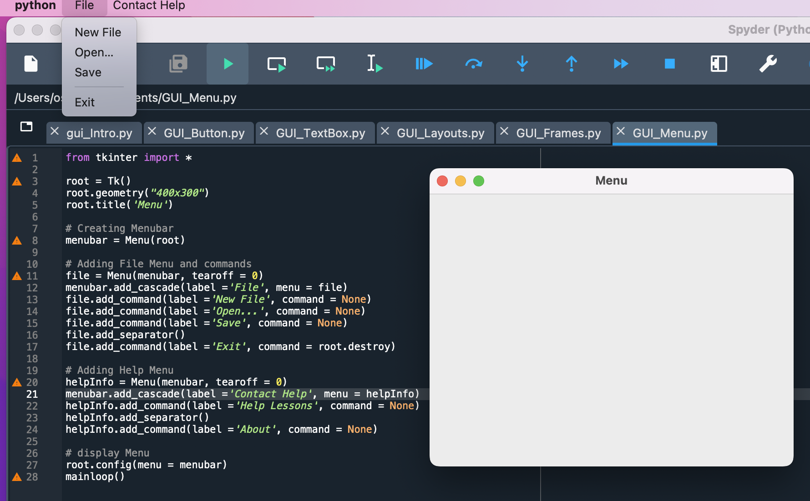
GUI
Menus

Slide 10
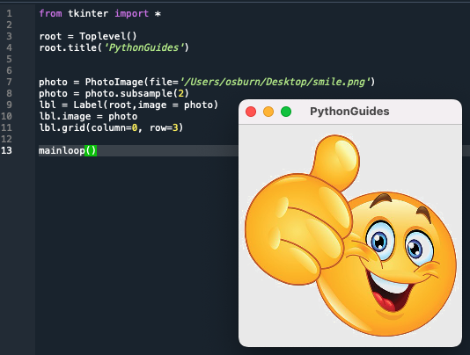
GUI
Images
Tkinter only supports GIF, PGM, and PBM.
To read JPGs you need to use the Python Imaging Library.

Slide 11
GUI
Event driven
A programming paradigm where the flow of the program is driven by sensor outputs or user actions (aka events) - Wikipedia
Batch programming - programming paradigm where the flow of events is determined completely by the programmer - Wikipedia
Notes:
2. World of Warcraft - Event
3. Any video game - Event
4. 401K Lab - Batch

Slide 12
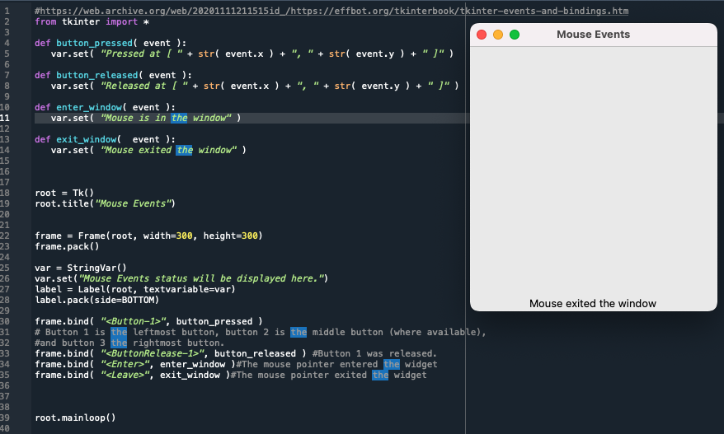
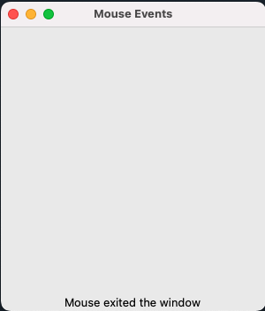
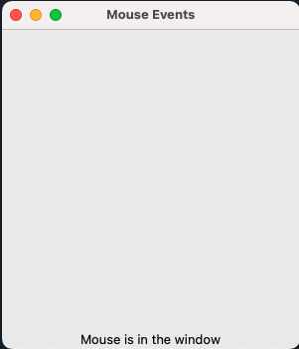
GUI
Mouse clicks
Events.
Bindings.

Slide 13
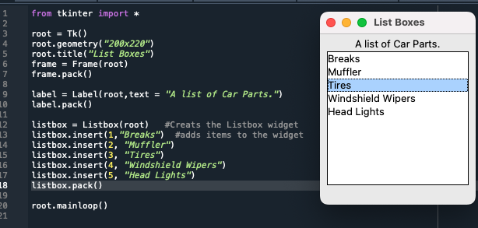
GUI
ListBoxes
selectmode = multiple
listbox.get(<int>)
listbox.curselection()

Slide 14
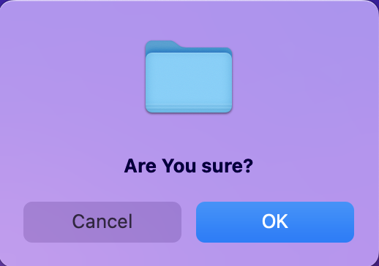
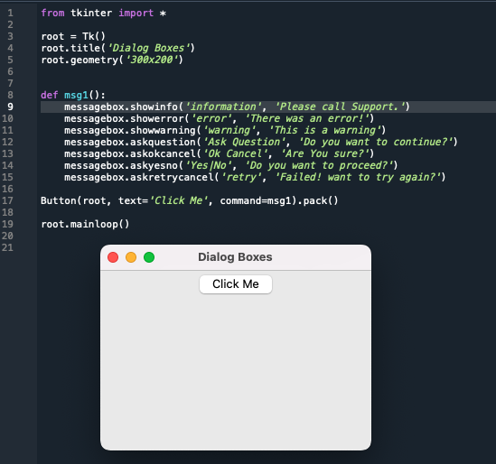
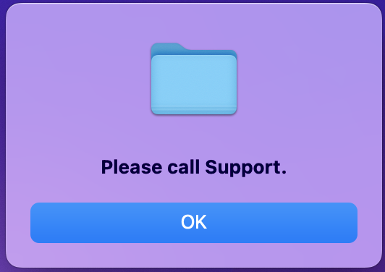
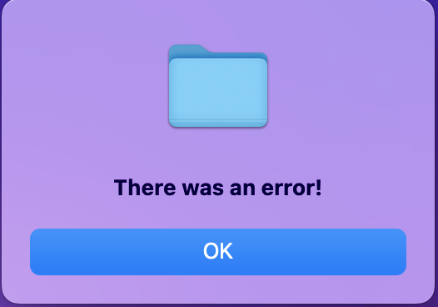
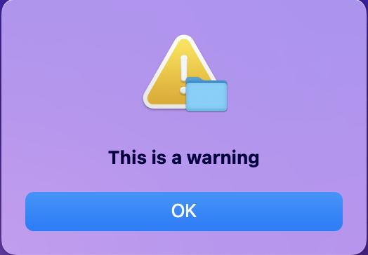
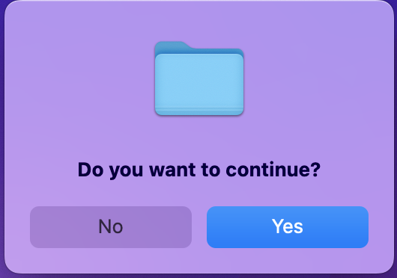
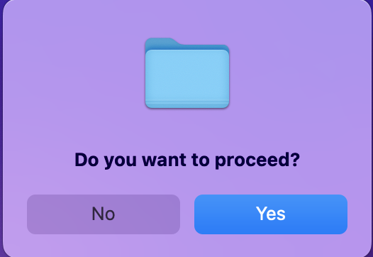
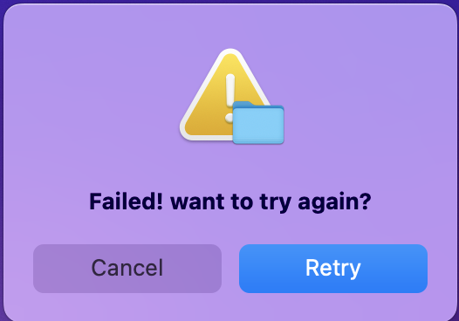
GUI
DialogBoxes

Slide 15
Demo

